Slide 1
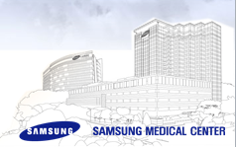
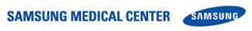
ICD/CRT의 새로운 신호처리 및 동작 알고리즘
(Multisensor algorithm for HF remote monitoring)
Juwon Kim
Samsung Medical Center

Slide 2
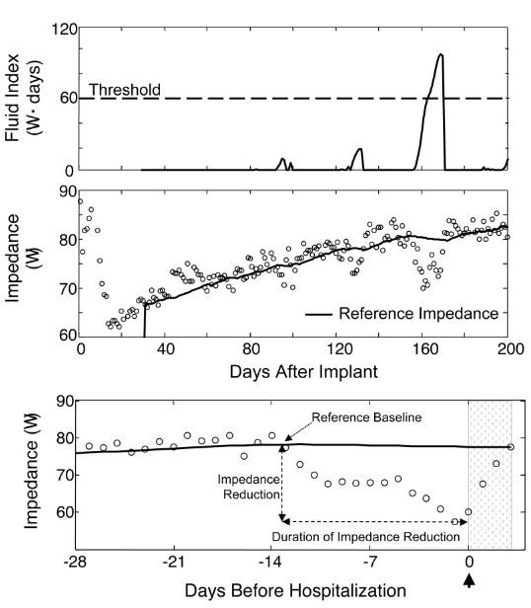
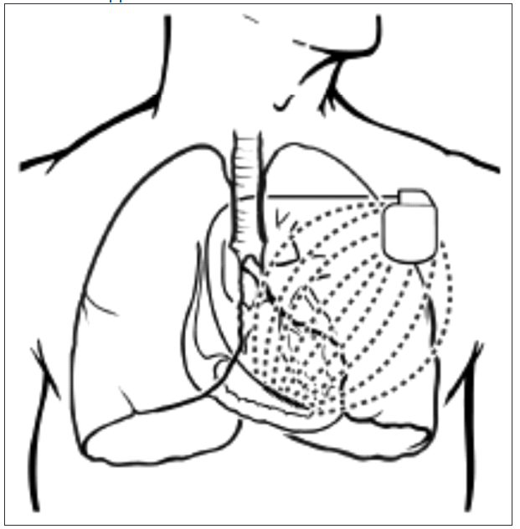
Intrathoracic Impedance Monitoring in Patients With Heart Failure
Circulation, 2005, 112, 841-848

Slide 3
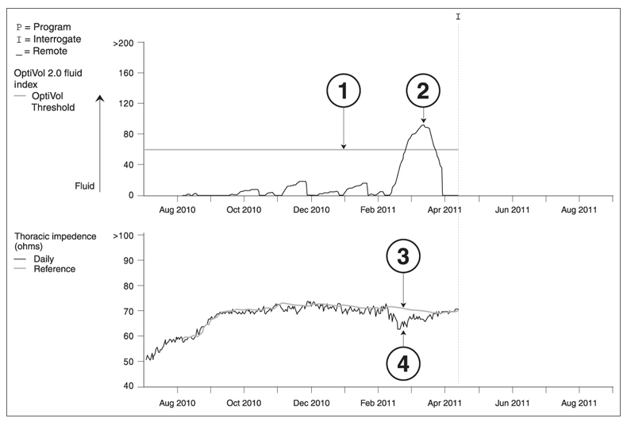
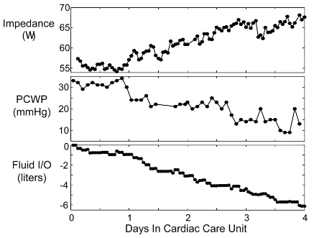
Intrathoracic Impedance Monitoring in Patients With Heart Failure
OptiVol®, CorVue™
Circulation, 2005, 112, 841-848

Slide 4
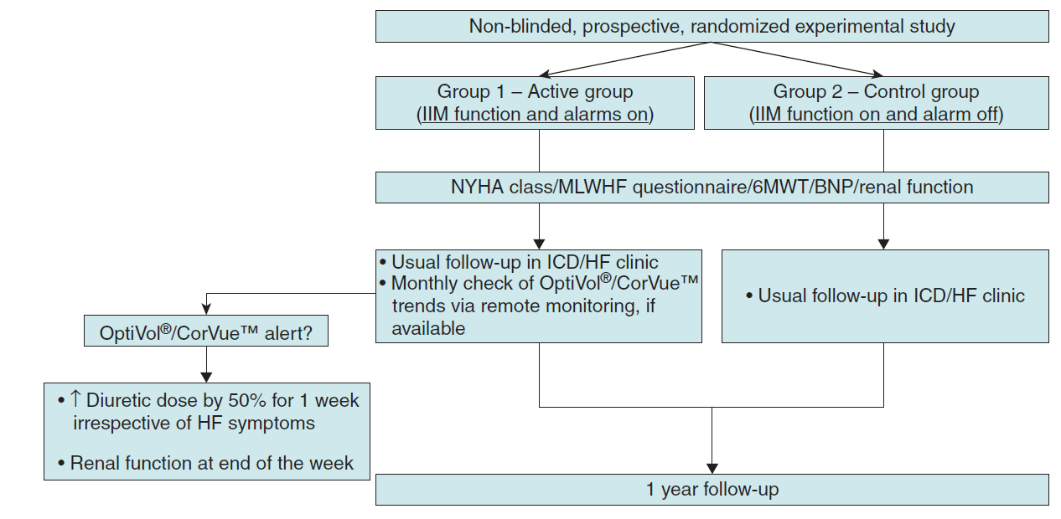
Intrathoracic Impedance Monitoring and Remote alarm
Europace (2016) 18, 428–435

Slide 5
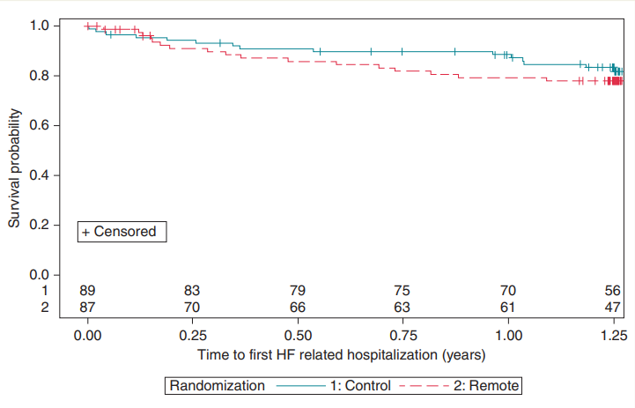
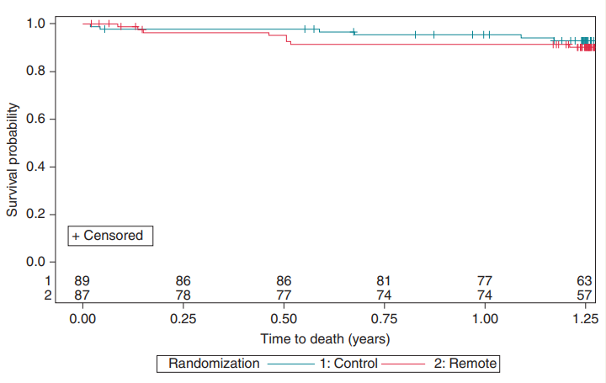
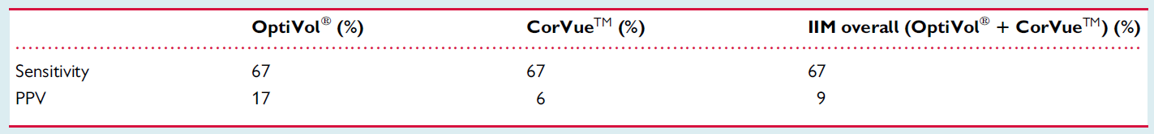
Intrathoracic Impedance Monitoring and Remote alarm
HF readmission
Mortality
Europace (2015) 17, 1276–1281
Europace (2016) 18, 428–435

Slide 6
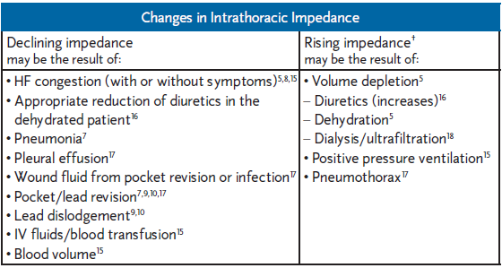
Intrathoracic Impedance Monitoring in Patients With Heart Failure

Slide 7
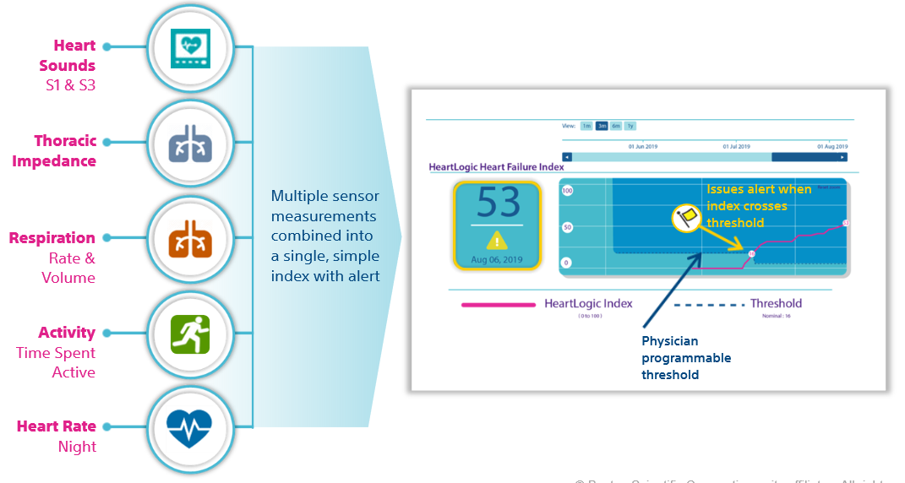
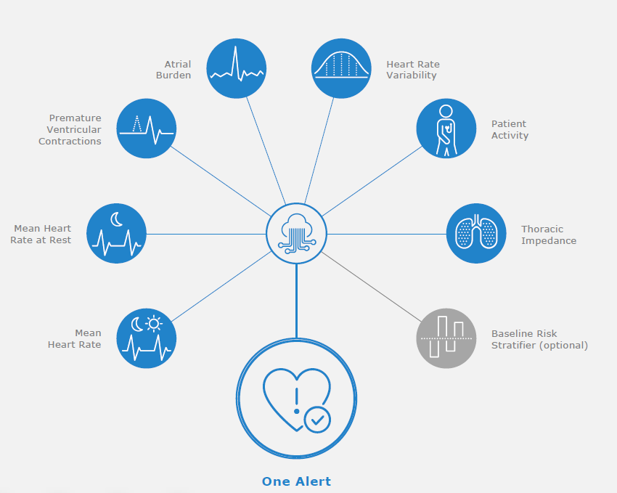
Multisensor algorithm for HF remote monitoring
HeartLogic™
HeartInsight™

Slide 8
Multisensor algorithm for HF remote monitoring
HF Risk Factors | Fixed Threshold Criteria
OptiVol™ | ≥ 30, ≥ 60, ≥ 100 fixed zones
Patient Activity | ≤ 60 min per day
AT/AF | ≥ 1 hour per day
Ventricular Rate during AT/AF | ≥ 90 bpm during AF ≥ 6 hours a day
% Ventricular Pacing | ≤ 90% (CRT device)
Shocks | Delivered
Treated VT/VF | ≥ 5
Night Ventricular Rate | ≥ 85 bpm or ≤ 55 bpm
Heart Rate Variability | ≤ 60 ms²
TriageHF™

Slide 9
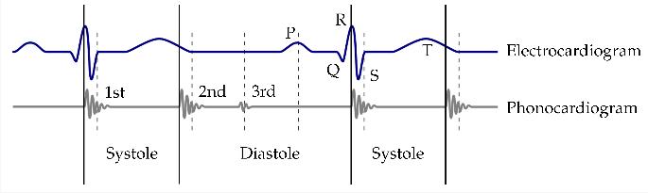
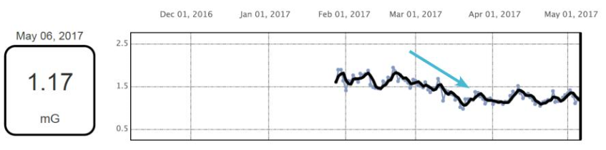




Multisensor algorithm for HF remote monitoring
S1 and S3 as determinants of Detecting early signs of Worsening HF
S1 intensity
myocardial depression, MR, VSD, acute aortic regurgitation
S3 intensity
impaired left ventricular functions(left atrial pressure) by early diastolic filling

Slide 10
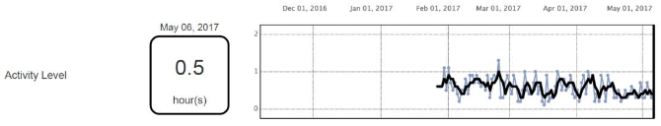
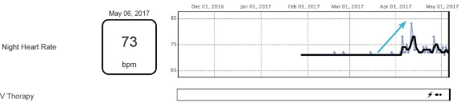
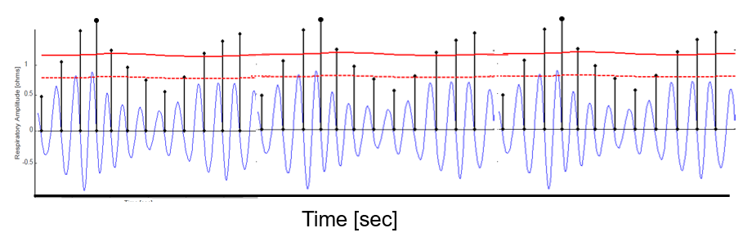
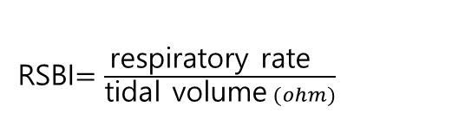
Multisensor algorithm for HF remote monitoring
Night Heart Rate(resting heart rate)
Activity
Respiration Rate
RSBI$=\frac{\text{respiratory} \text{rate} }{\text{tidal} \text{volume} (ohm)}$

Slide 11
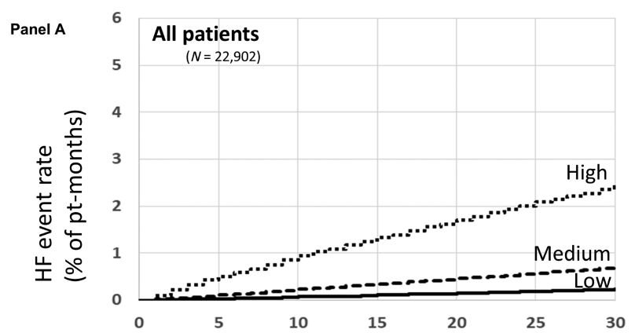
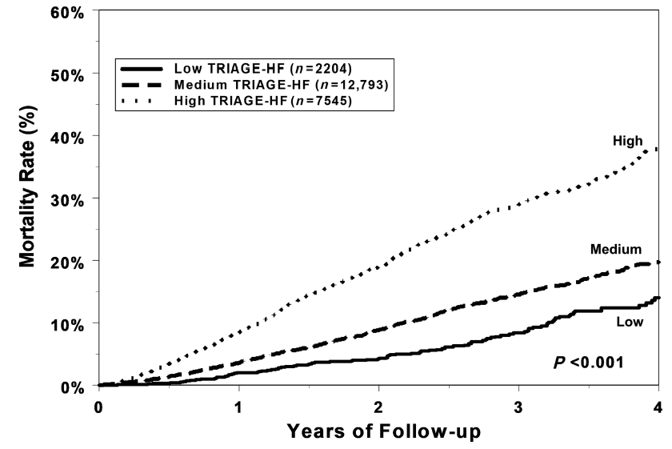
Multisensor algorithm for HF remote monitoring
HF readmission
Mortality
ESC Heart Failure 2020; 7: 4277–4289

Slide 12
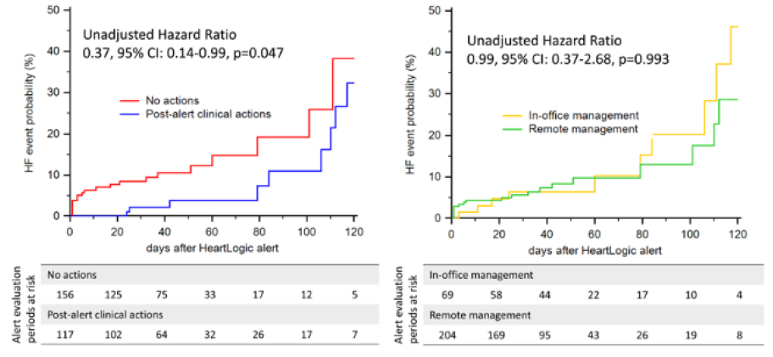
Multisensor algorithm for HF remote monitoring
BNP combine
Post-alert clinical action
Remote management
Circ Heart Fail. 2018;11:e004669.
Circ Heart Fail. 2021;14:e008134.

Slide 13
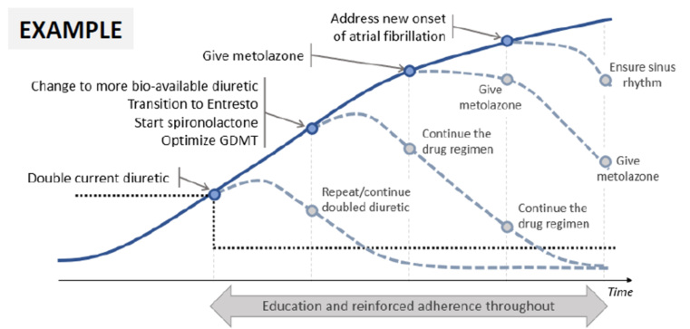
MANAGE-HF phase 1 single arm, In alert → remote clinical action
Multisensor algorithm for HF remote monitoring
J Cardiac Fail. 2022;28

Slide 14
J Cardiac Fail. 2022;28

Slide 15
5 SAE of 585 alert cases
  2 Renal insufficiency
  1 dizziness
  1 syncope
  1 abnormal lab finding
J Cardiac Fail. 2022;28

Slide 16
History
# persistent AF - RFCA (21.10.13, PVI, box)
; HBP, DM, HF
# DCMP s/p ICD (17.12.11 DDD, single, boston)
-> A lead failure
# lymphoma
# CKD

Slide 17
Event
21.10 RFCA for AF
21.12 ADHF 로 adm
22.2.14 opd 내원시 숨찬 증상으로 이뇨제 증량
22.3.28 r/o ADHF 로 ER – COVID 확진
22.4.23 ADHF

Slide 18
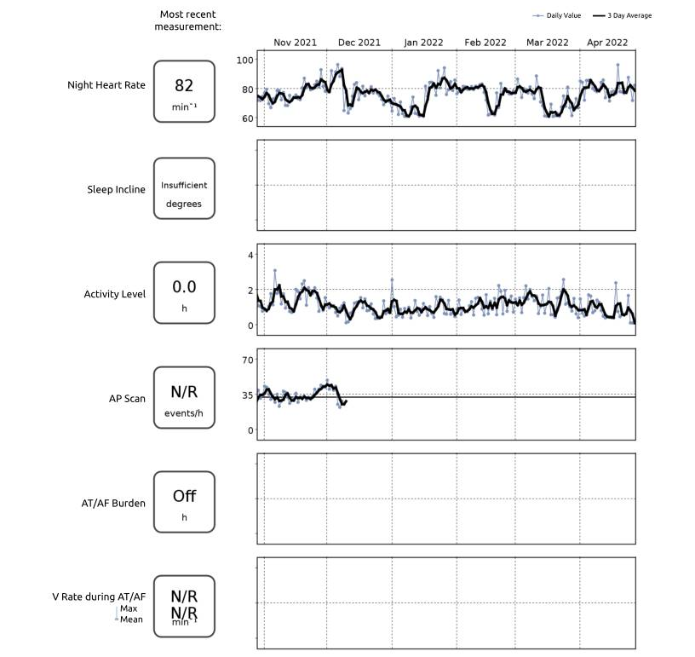
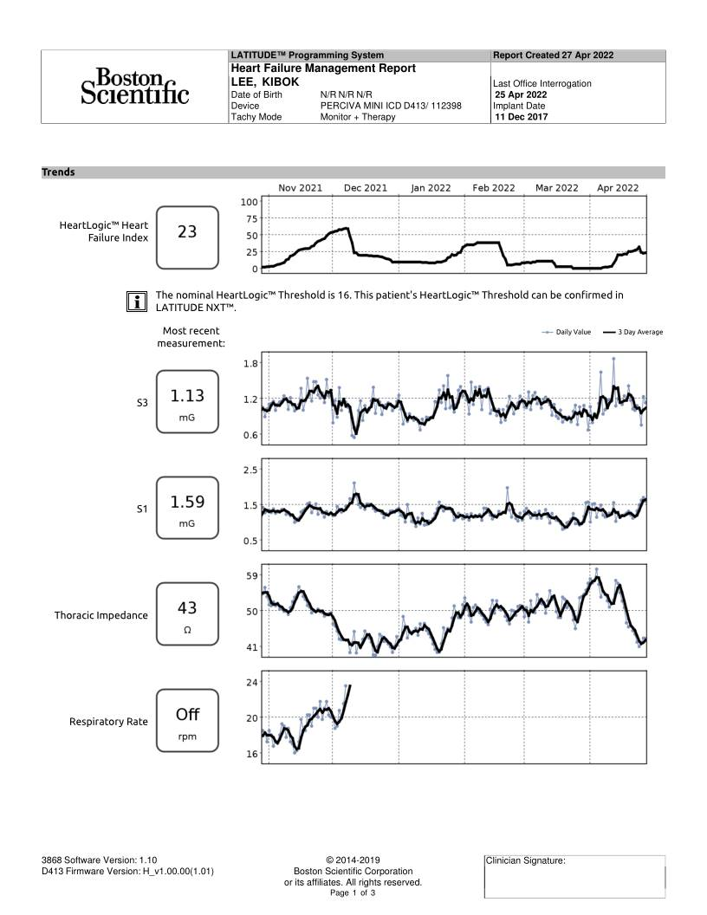
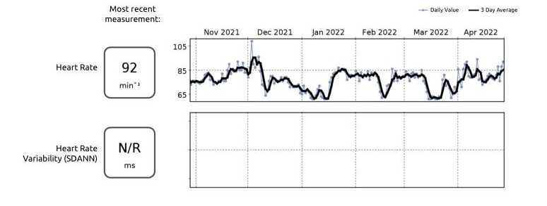

Slide 19
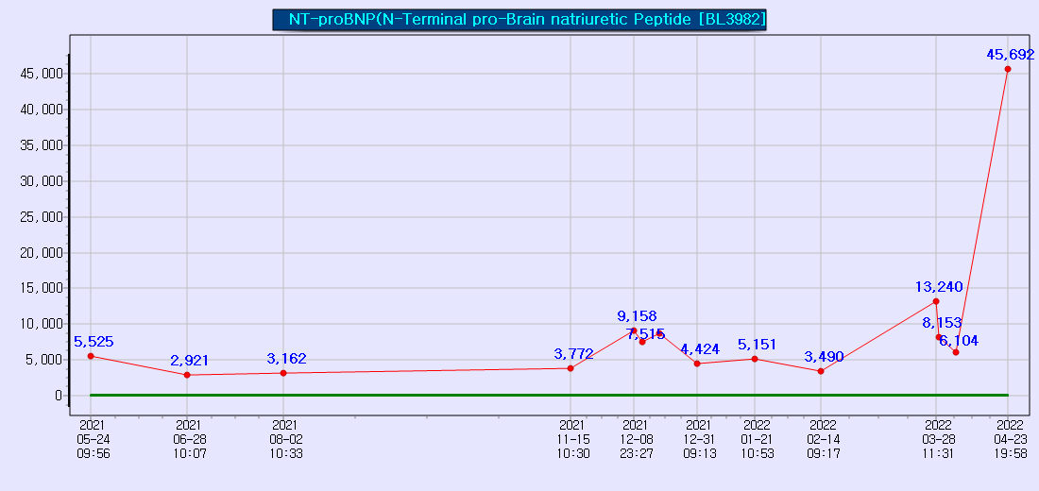

Slide 20
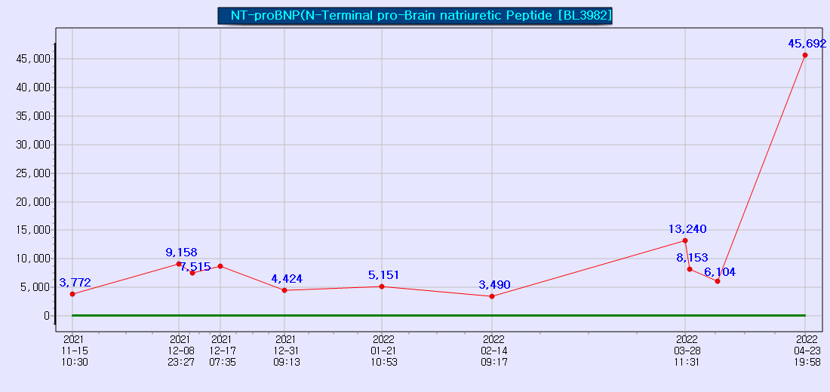
2021.10.13
AF RFCA
2021.11.19
OPD – dyspnea 로 입원장
2021.12.8
ADHF
2022.2.14
OPD – dyspnea 로 이뇨제 증량
2022.3.28
COVID
2022.4.26
ADHF

Slide 21
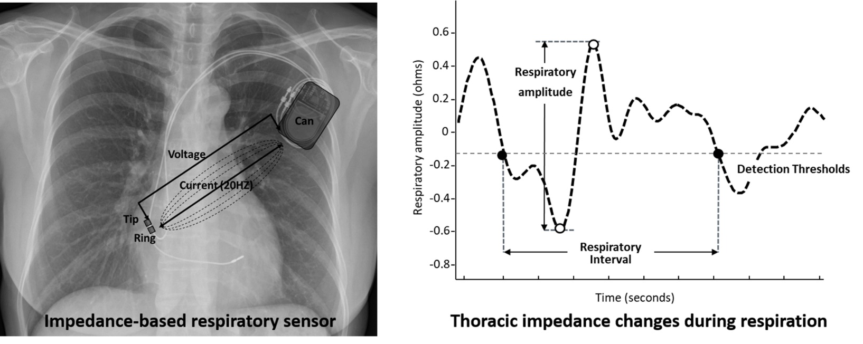
Apnea ScanTM for
CIED-detected sleep-disorderd breathing (SDB)
Int J Cardiol. 2019;280:69-73

Slide 22
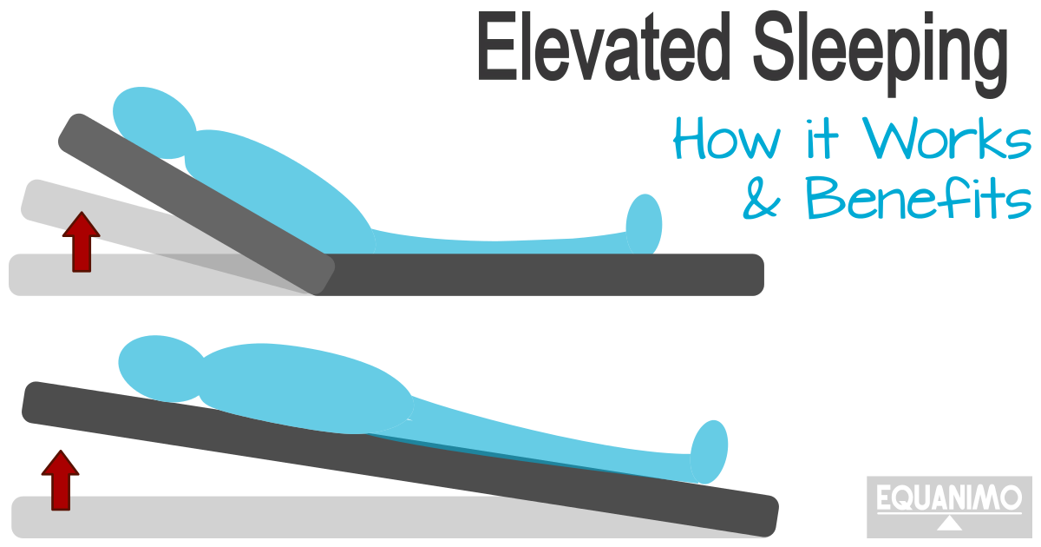

Sleep Incline

Slide 23
Association between heart failure aggravation and device-based sensor parameters – HeartLogicTM, Sleep incline, and Apnea ScanTM
Prospective observational multicenter study
300 patients in 15 centers

Slide 24
Study Objective
To prospectively investigate association between HF aggravation and
changes in DS parameters such as HeartLogic index, Sleep incline, and Apnea Scan.
To prospectively evaluate association between HF improvement and change in DS parameters.
To prospectively assess whether multiple DS parameters measurement show better performance in the prediction of HF aggravation (or improvement) than single (clinical or DS) parameter measurement (clinical or DS).
Cf. clinical parameters include left ventricular ejection fraction, NT-proBNP (N-terminal pro-B-type natriuretic peptide), 6-minute walk, etc.

Slide 25
Participating centers
Samsung Medical Center, Kangbuk Samsung Hospital, Samsung Changwon Hospital,
Asan Medical Center, Gachon University Gil Medical Center, Veterans Health Service Medical Center
Wonju Severance Christian Hospital, Chungnam National University Hospital, Soon Chun Hyang University Hospital, Gyeongsang National University Hospital, Daegu Catholic University Medical Center, Korea University Medical Center, Chungbuk National University Hospital, Chung-Ang University Hospital, Inha university hospital, Sejong General Hospital

Slide 26
Inclusion/Exclusion Criteria
Inclusion Criteria
Subject who has legal age to give informed consent specific to each country and national laws.
Subject who has a documented diagnosis of HF (HFrEF & HFpEF including HCM, RCM, etc).
Subject who undergoes implantation of Boston Scientific ICD or CRT-D with HeartLogic, Sleep incline, and Apnea Scan sensors.
Subject who is enrolled in LATITUDE (NXT 5.0 or future version), and is willing to use remote monitoring system.
Exclusion Criteria
Subject who has received or is scheduled to receive a heart transplant or ventricular assist device (VAD) within 12 months.
Subject who has a life expectancy of less than 12 months.
Subject who has a history of non-compliance to medical care or known inability to comply with requirements of the clinical study protocol.

Slide 27
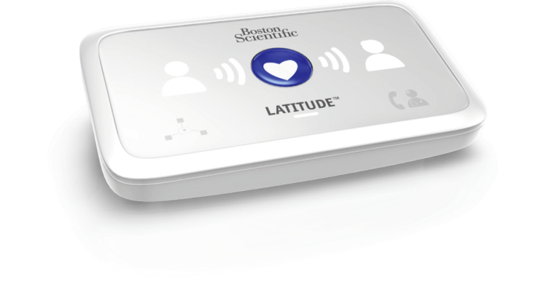
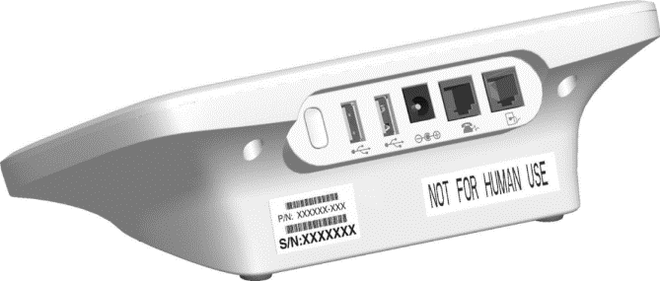
Latitude NXT

Slide 28
 |  | Enrollment visit | Baseline visit | Device interrogation follow up visit⁷
 |  | 시술 후 31일 이내 | 시술 후 7일-31일 이내 | 3M(±60) Follow up | 6M(±60) Follow up | 9M(±60) Follow up | 12M(±60) Follow up | 15M(±90) or Last Follow up
연구설명 및 동의서 취득¹ |  | ●
기본 관찰 항목² |  | ●
관찰검사³ | 혈액검사 | ▲ |  |  |  |  |  | ▲
 | 심전도검사 | ▲ |  |  |  |  |  | ▲
 | 심장초음파검사 | ▲ |  |  |  |  |  | ▲
 | 흉부 X-RAY | ▲ |  |  |  |  |  | ▲
LATITUDE Set-up (원격 관찰 시스템) |  |  | ●
수면 시 높이 기울기 측정 (Sleep incline sensor) |  |  | ●
추적관찰 방문 (표준치료) |  |  |  | ● | ● | ● | ● | ●
원격 추적 관찰 (매월) ⁴ |  |  |  | ● | ● | ● | ● | ●
Alert 추가활동⁵ |  |  |  | ● | ● | ● | ● | ●
설문조사 (HoMASQ)⁶ |  |  |  |  |  |  |  | ●
이상반응 (Adverse event) |  | ● | ● | ● | ● | ● | ● | ●

Slide 29
Objective
Primary Objective
Change in DS parameters according to HF event*
*, HF events: HF-hospitalization, unplanned ER visit with subsequent modification of HF medications, or unplanned clinic visit with modification of HF medications.
Secondary Endpoint
• Post-discharge 1- or 3-month HF-hospitalization based on DS parameters measured within 3 days prior to discharge (among patients with HF-hospitalization).
• Arrhythmic events (new-onset AF, AF progression, AF burden, Ventricular tachycardia or fibrillation) according to DS parameters.
• Overall and cardiovascular Mortality according to DS parameters.
• Stroke, TIA, or systemic embolism according to DS parameters.
• Assessment of usability (including patient satisfaction) of LATITUDE (remote monitoring) system

Slide 30
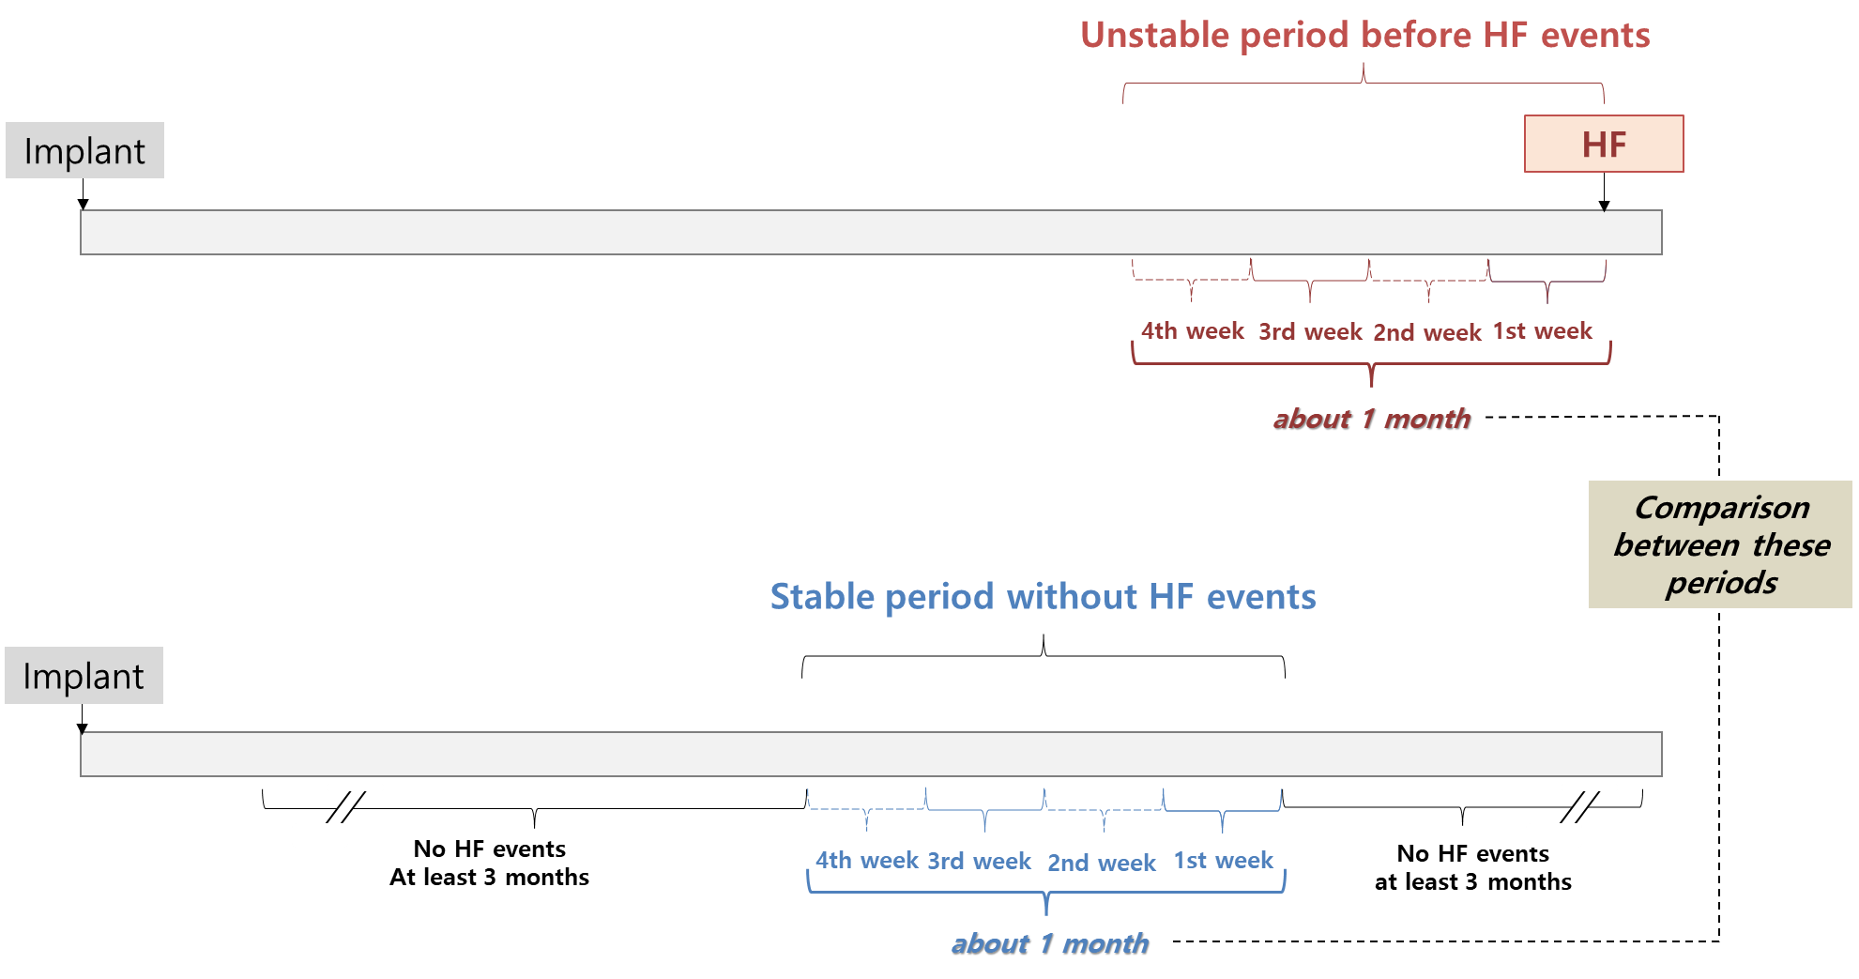

Slide 31
Thank You For Your Attention !
Juwon Kim, MD
Heart Vascular Stroke Institute,
Samsung Medical Center, Seoul, Republic of Korea
If you have any question, don’t hesitate to e-mail me.
abcd186a@naver.com ; abcd186a@gmail.com

